Slide 1
Issaquah School District – Preliminary Demographic Observations
Shannon L Bingham
Western Demographics, Inc.
1/26/23

Slide 2

Issaquah School District – Demographics and Enrollment Findings
Issaquah School District (ISD) is being affected by significant local, regional and National demographic and social dynamics that have affected enrollment
Housing costs in the district have risen and priced many young families out of the regional market
The Millennial generation population is not having children the rate of prior generations and birth rates and preschool and elementary school populations are diminished
The Pandemic resulted in many families choosing school alternatives other than neighborhood in person schools – this has affected enrollment and changes have been permanent
Interest rates will be elevated for the next 18 – 24 months and home sales are diminished with little inventory available to new buyers
Enrollment is expected to decline slightly during the next five years until significant new housing development increases the overall population

Slide 3
Post Pandemic School Demographics – National Perspective
The Millenial-age population is not having children at the rate of prior generations
Birth rates and family sizes have declined in almost every State and throughout Washington
Housing costs in the Puget Sound region have affected family size and location decisions for many young families
The Pandemic worsened already declining enrollments (Pandemic-linked enrollment declines average 3% among suburban districts in the West and have been largely permanent)
Competition from on-line and non-neighborhood schools has accelerated as families try them and continue post Pandemic

Slide 4
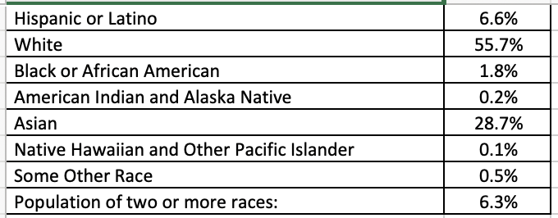
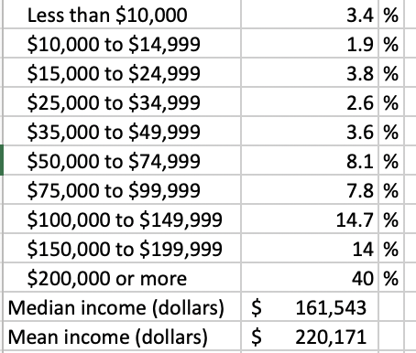
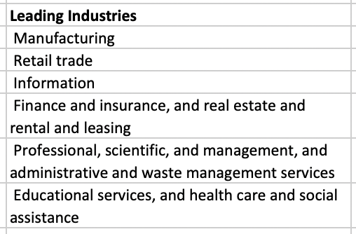
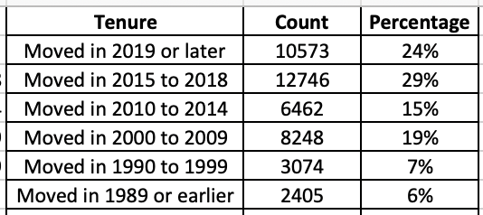
Issaquah School District – Basic Demographics
Income by Grouping and Percentage
Race
Employment
Tenure

Slide 5
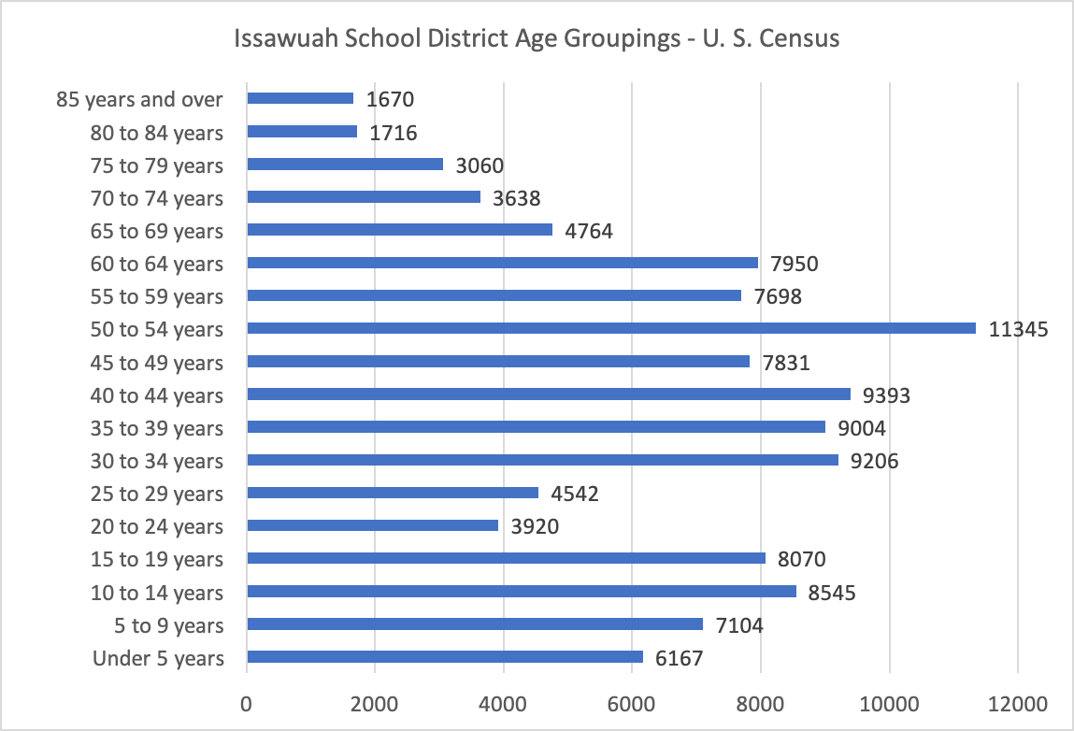
Issaquah School District Age Groupings
Population distribution in the district is balanced with families and school-aged population well represented. The preschool age cohort is diminished.
Retirement
Empty-nester
Families
College/Career
School-aged
Preschool

Slide 6
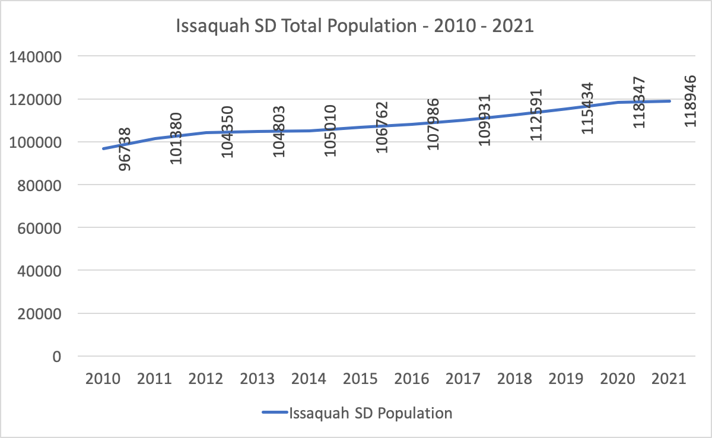
Issaquah School District – Total Population – 2010 - 2021

Slide 7
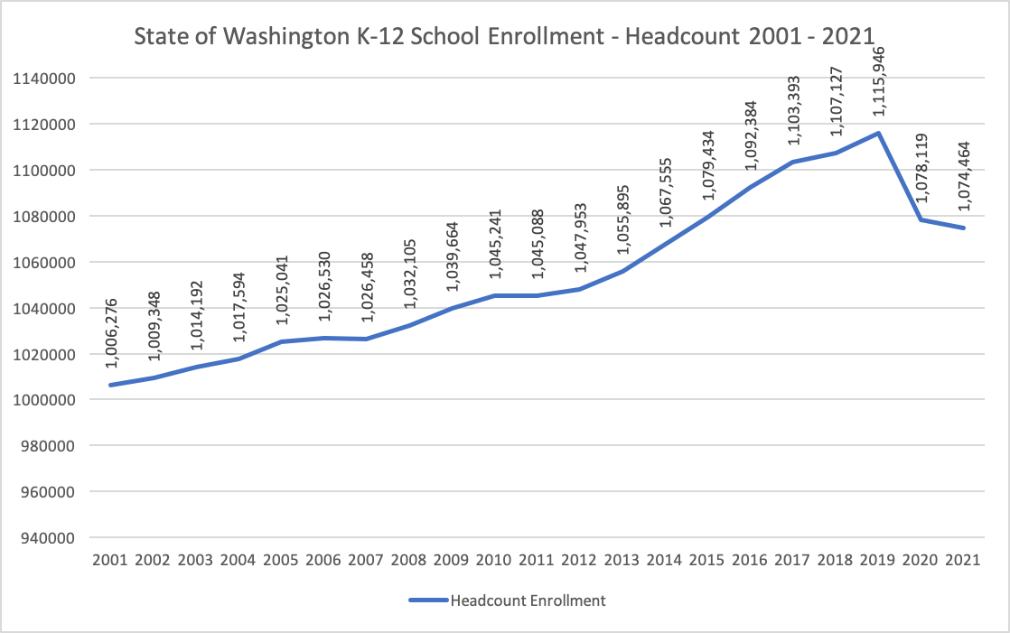
Washington State Enrollment Trend – 2001 - 2021

Slide 8
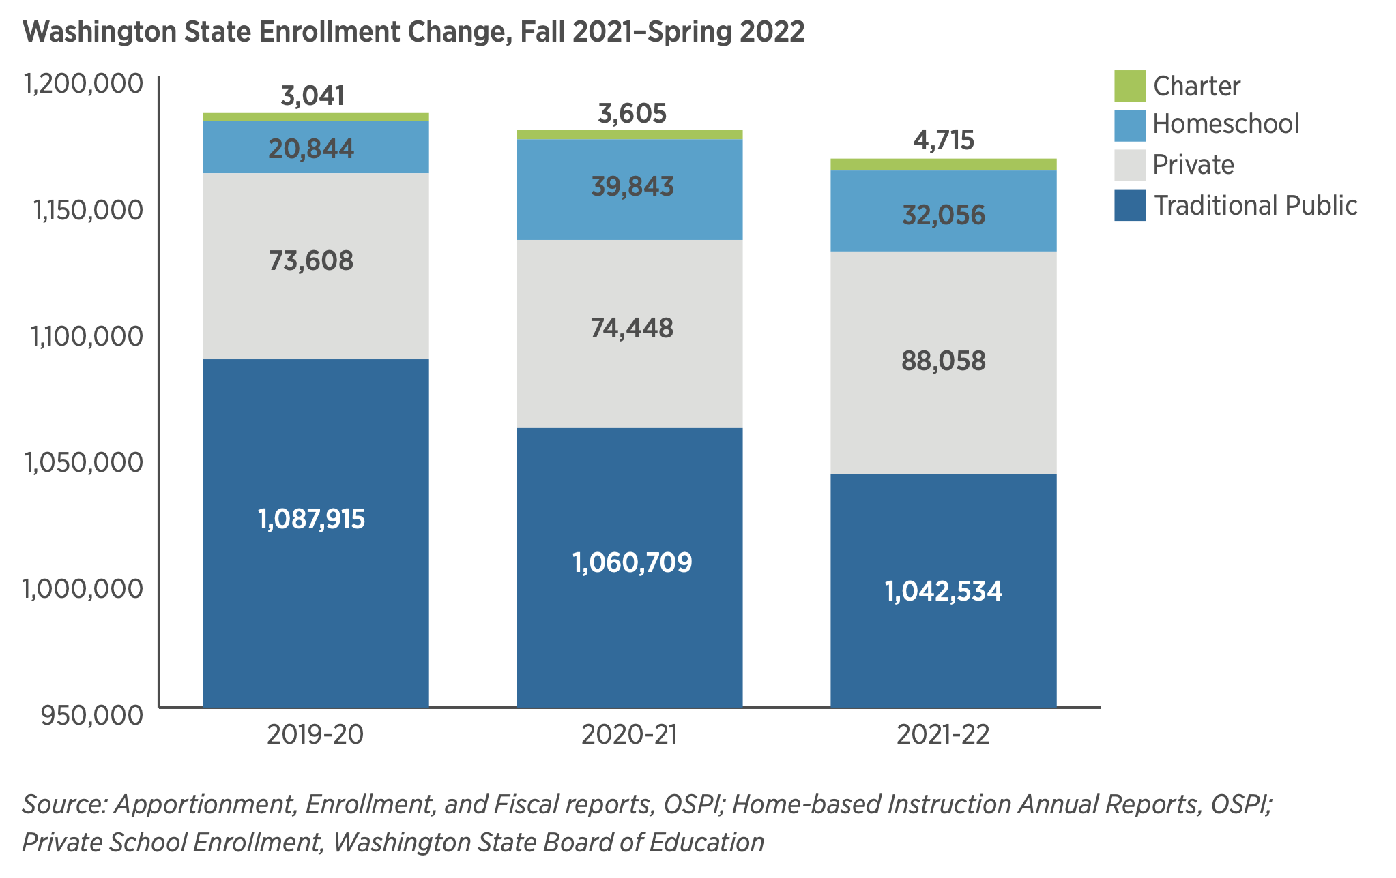
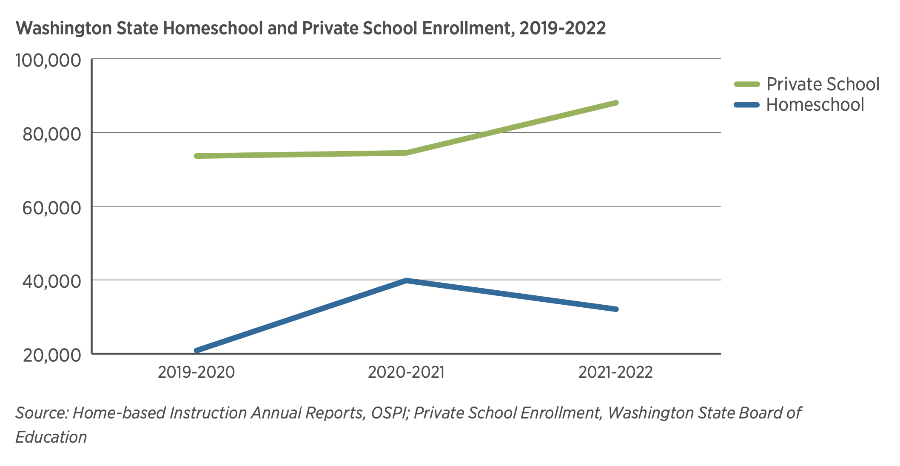
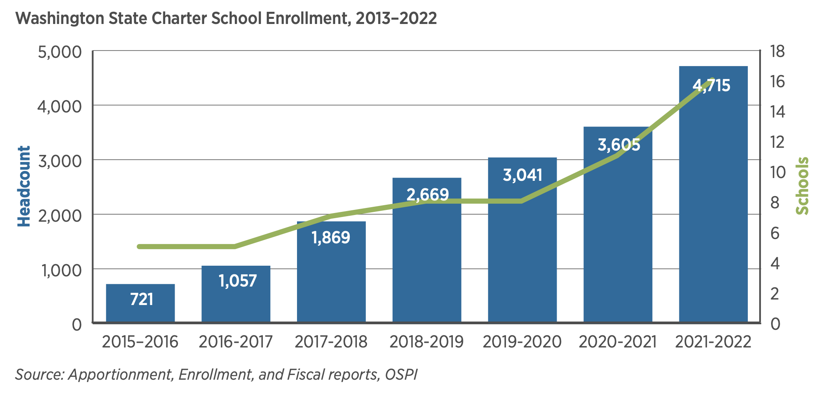
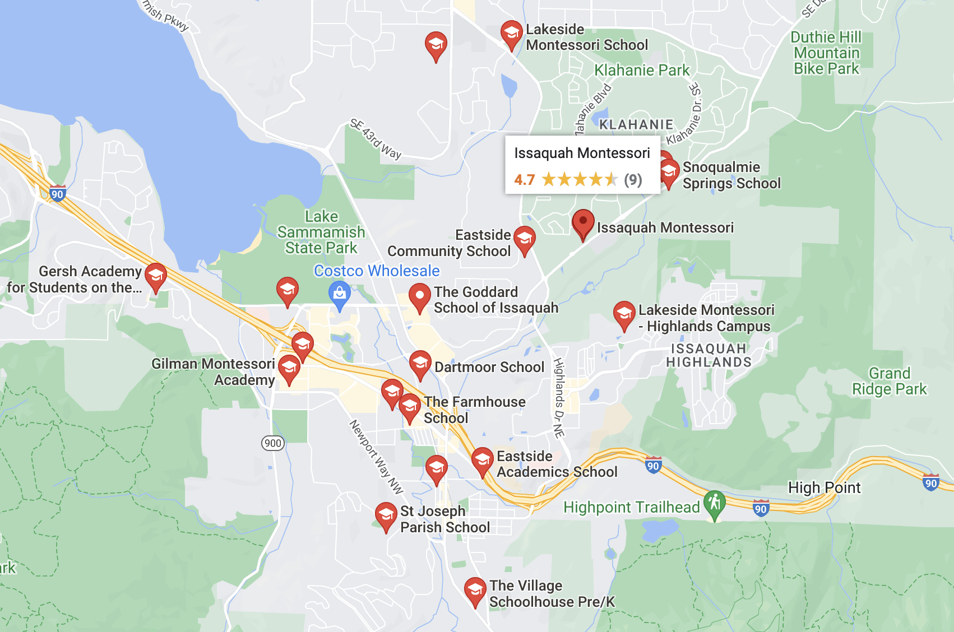
Washington State Trends – Charter and Private Schools Up, Neighborhood Schools Down
Private Schools in Issaquah
Data from OSPI
Data from Google

Slide 9
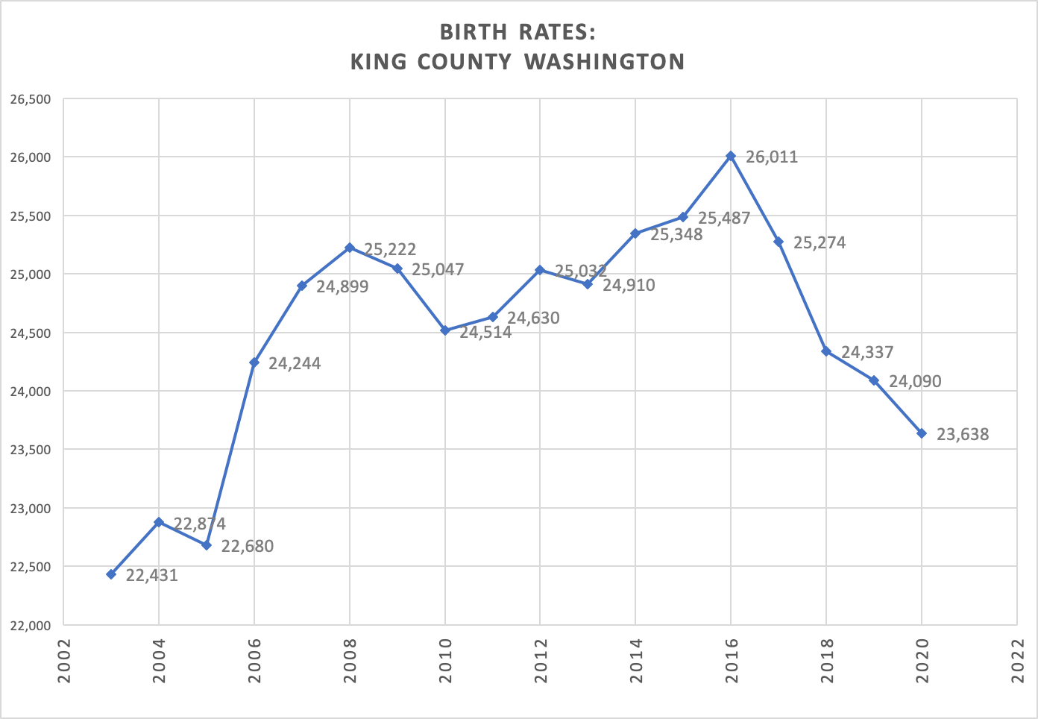
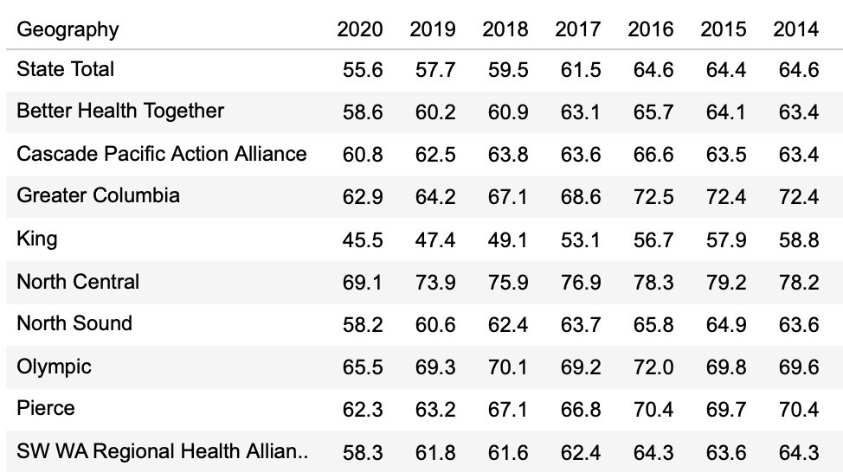
King County Births – 2002 - 2020
Birth rates have declined Nationally and fewer school-aged children are available. Issaquah rates are included in the King County total and follow a similar trajectory. With fewer babies available, future kindergarten populations are expected to decline.
King County Birth rate decline leads the rest of the state.
King County
Washington State birth rates by region.
Data from Washington Health

Slide 10
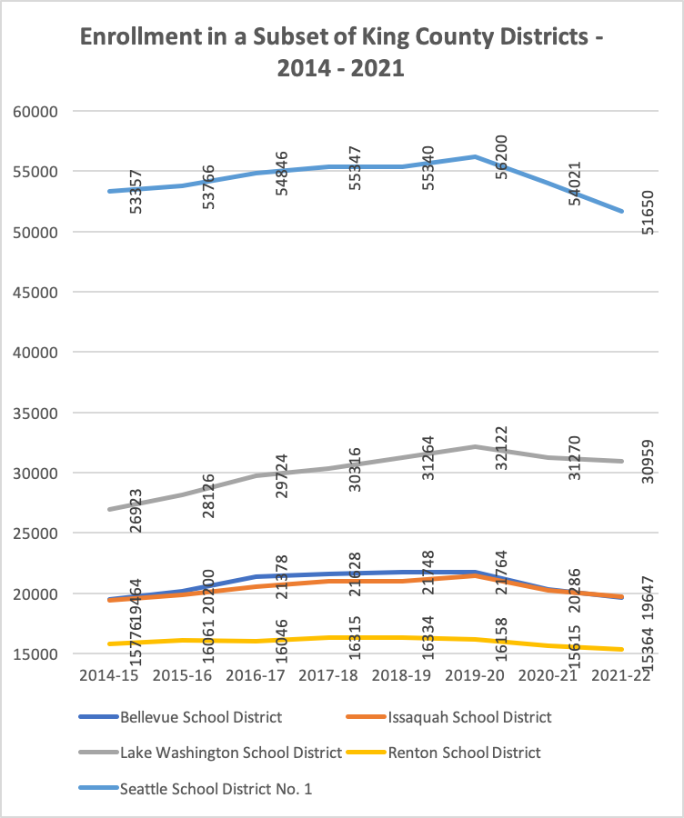
Five King County Districts that have Lost K-12 Enrollment –
(Issaquah is not alone in its recent loss of students.)
King County

Slide 11
King County School Districts – PK-12 Enrollment
2014 – 2021 – (Enrollment Declines are Pervasive)
King County

Slide 12
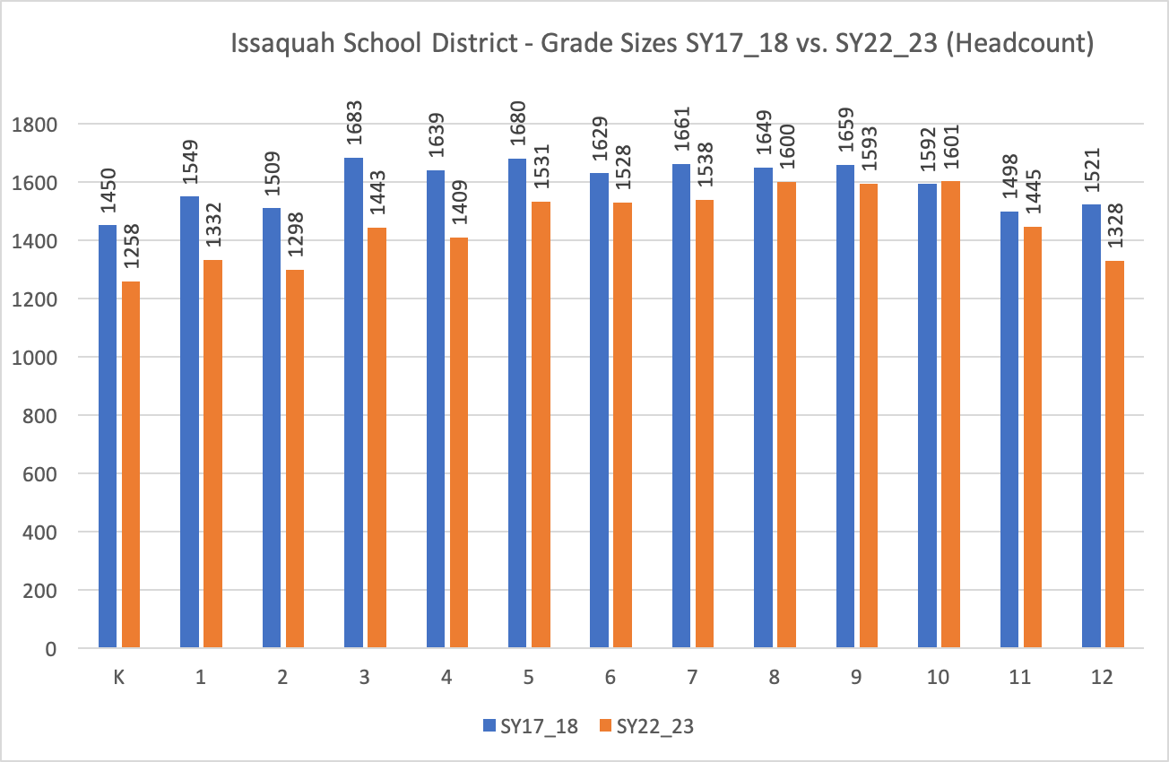
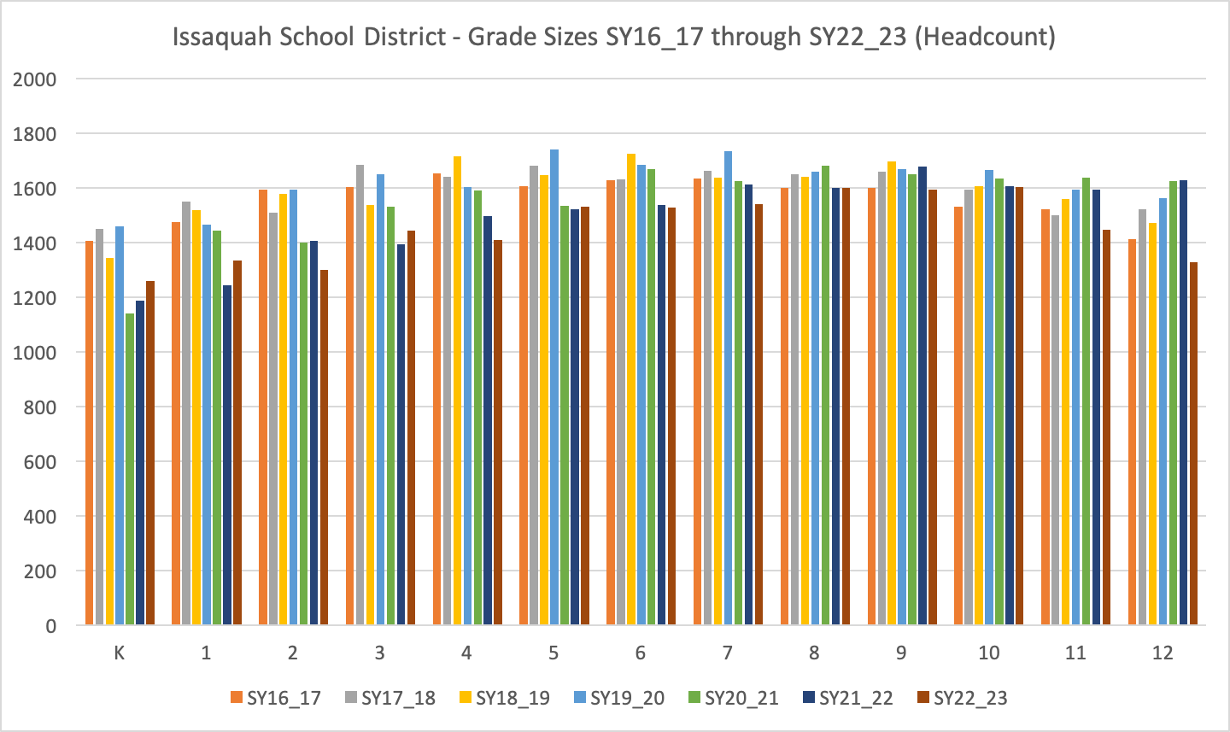
Issaquah School District Grade Distribution
Grade sizes in grades kindergarten through eight have declined during the past five years.
Grade size decline has been gradual and consistent.

Slide 13
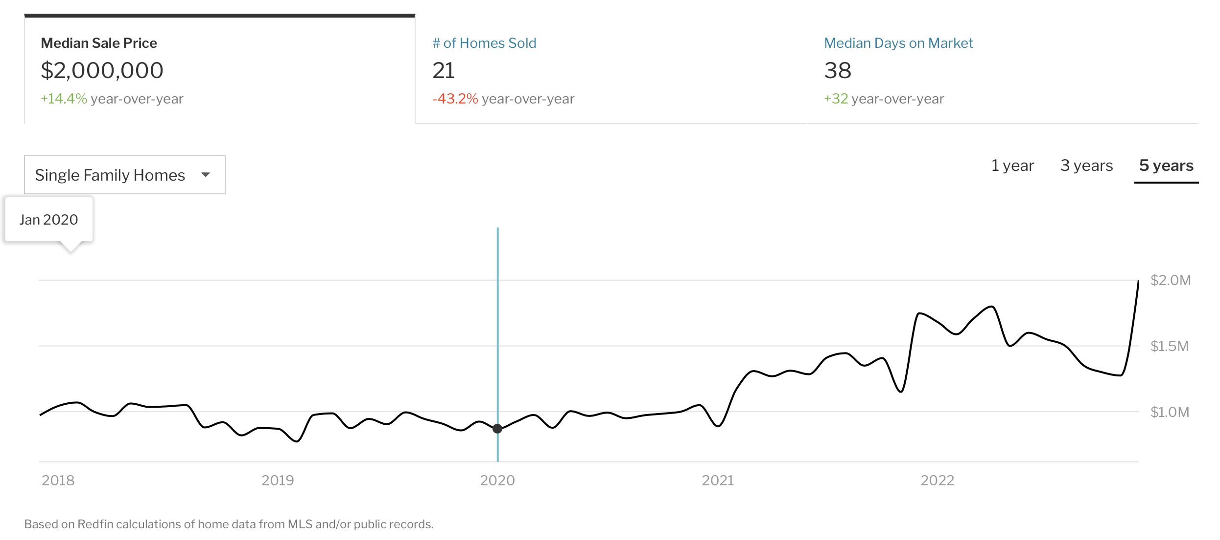
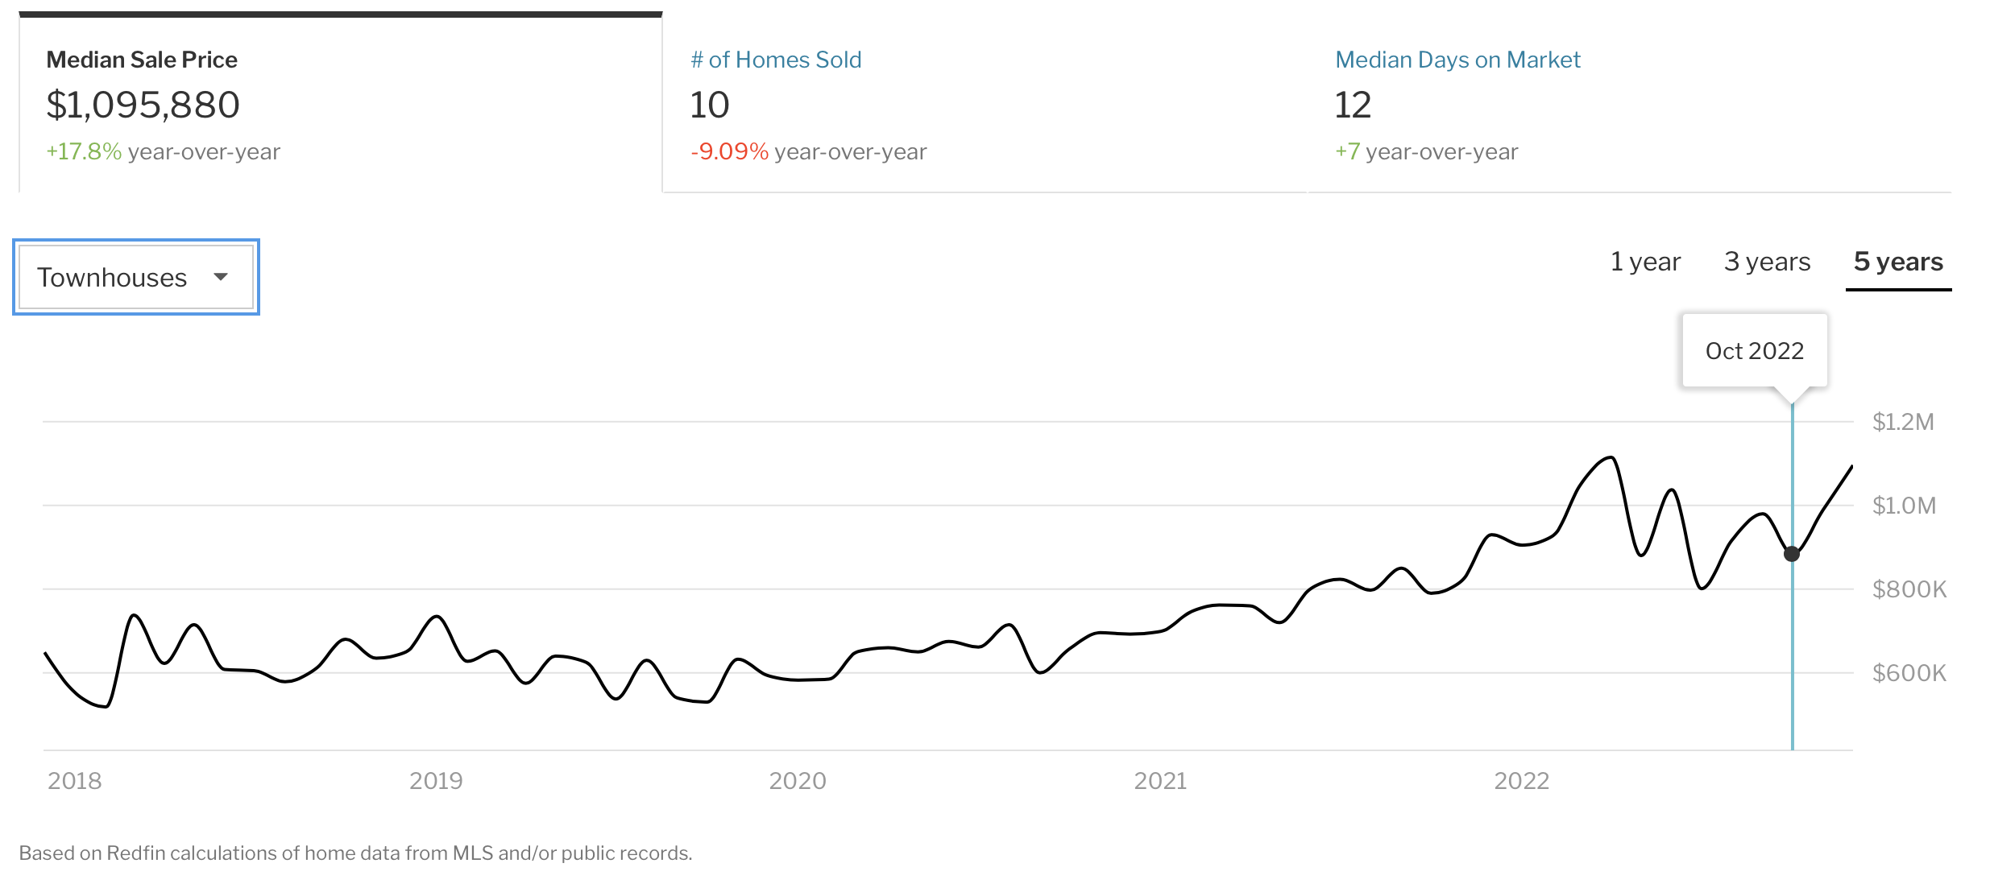
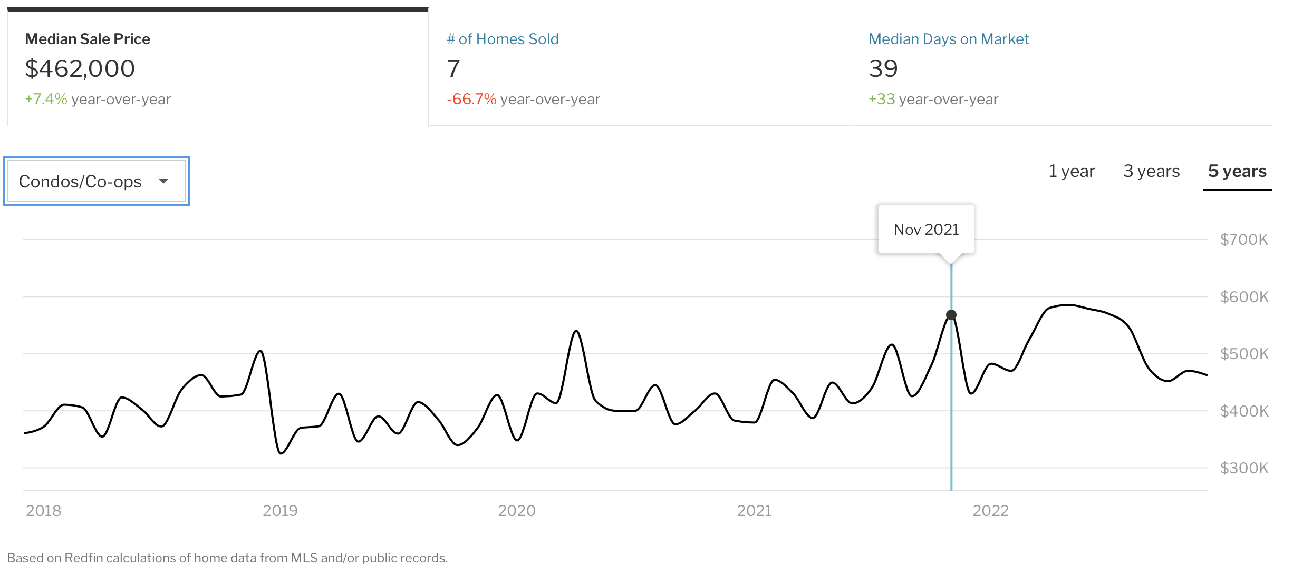
Housing Prices Have Risen as Inventory has Diminished
There are few homes available and interest rates have risen to 7% and above
Single Family Homes – Average Price $2M
Townhomes – Average Price $1.1M
Condos – Average Price $462,000
Data from Redfin

Slide 14
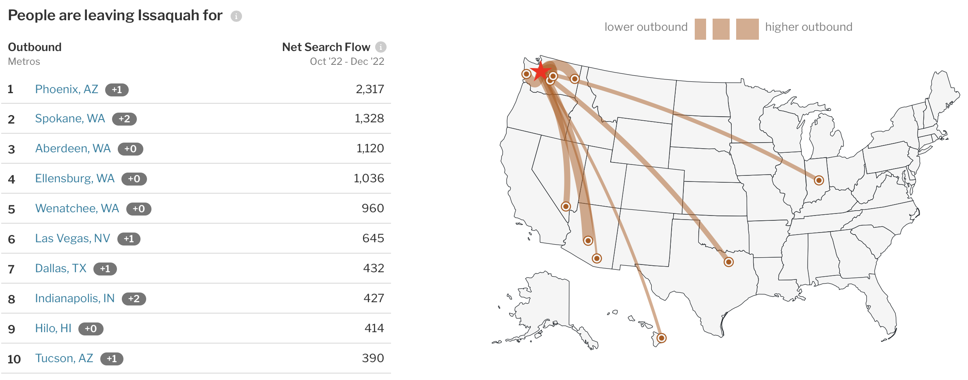
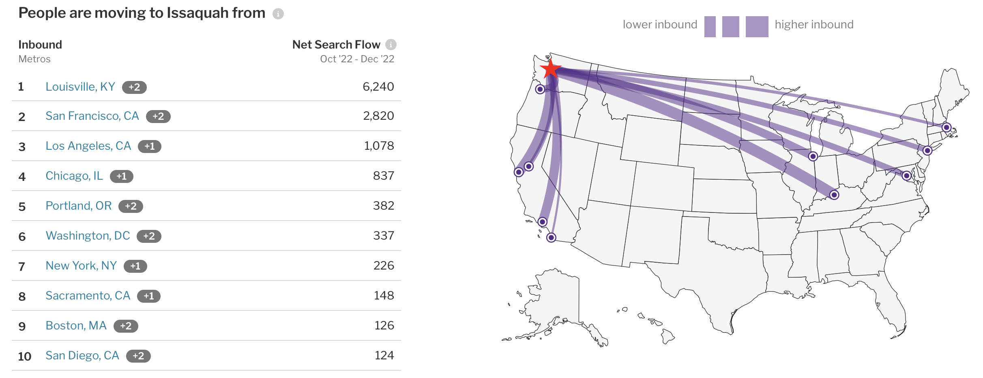
Origin and Destination of Home Buyers / Sellers
Residents who are leaving are generally headed for less expensive housing markets in Eastern and Southern Washington, Texas, Arizona and Nevada.
Home buyers are largely in-bound from expensive housing markets where they may have significant equity to contribute to a purchase.
Data from Redfin

Slide 15
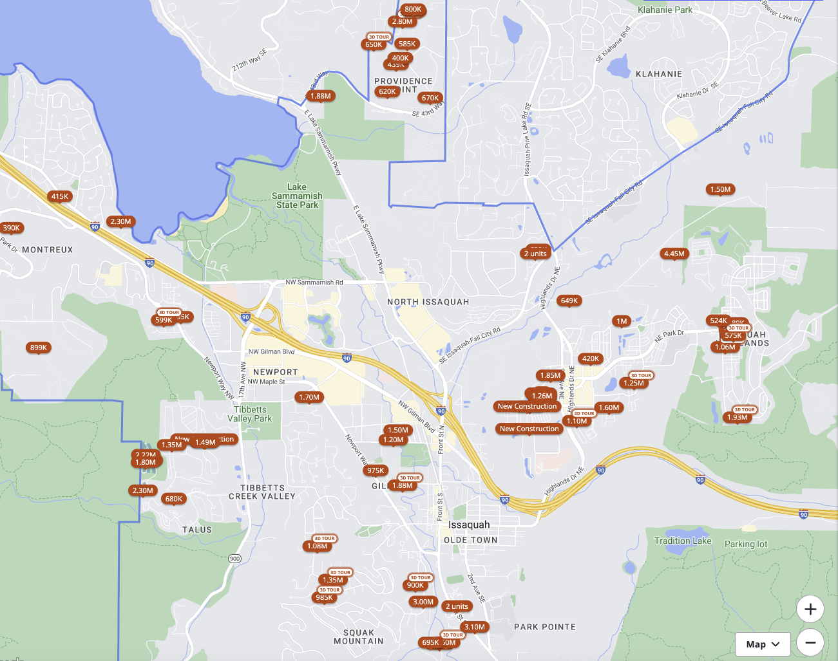
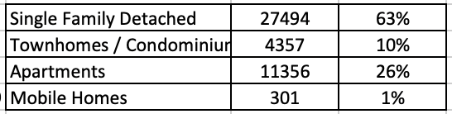
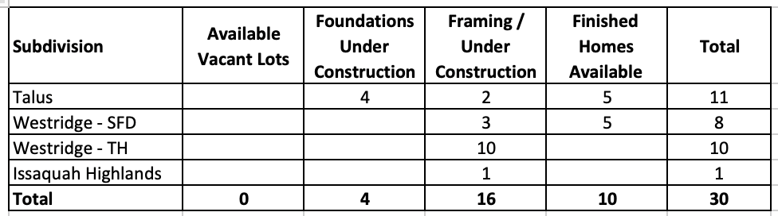
Housing Observations
56% of Issaquah residents own their homes
Housing availability is limited with
  Zillow listing only 100 homes available in January of 2023 and
  Redfin listing 107 available
Interest rates have had a significant effect on the market
  38 homes sold in December of 2022 (35 days on market)
  69 homes sold in December of 2021 (6 days on market)
Very little new housing infrastructure was under construction in the field
Housing by Type
30 Homes Under Construction in Jan 23
Zillow

Slide 16
OSPI Headcount Grade Cohorts – K-12

Slide 17
DRAFT K-12 Enrollment Forecasting Given Current Enrollment and Conditions
Draft Forecasting
Low
Cohort Change Grade to Grade
Medium
Cohort Change Basis Grade to Grade
High

